Slide 1


PAAVAI ENGINEERING COLLEGE (AUTONOMOUS) DEPARTMENT OF INFORMATION TECHNOLOGY A NEW CLASSFICATION METHOD FOR RICE VARIETY USING
DEEP LEARNING
THIRD REVIEW BATCH NO: 11
GUIDED by: PRESENTED by:
MS.VANMATHI, S.DHANUSH KUMAR (20202014)
B.E, M.E, P.SAM(20202045)
Professor, Department of IT, K.SRIRAM(20202054)
Paavai Engineering College.

Slide 2
ABSTRACT
Rice, which is among the most widely produced grain products worldwide, has many genetic varieties.
These varieties are separated from each other due to some of their features. These are usually features such as texture, shape, and color.
With these features that distinguish rice varieties, it is possible to classify and evaluate the quality of seeds.
Image processing techniques are combined with neural networks to provide more accuracy in the training model rather than the manual process.
It includes Densenet framework to classify the rice varieties with improved accuracy.

Slide 3
OBJECTIVE
The main objective is classify rice images using transfer learning algorithm
It includes DenseNet framework algorithm for build model with multiple images

Slide 4
INTRODUCTION
Rice is the most developing crop all over India; with the increase in population, demand for rice grains has also increased.
It is cultivated in almost every Asian country and exported worldwide.
In India, many quality standards for rice production are made available.
These include physical appearance, cooking qualities, scent, taste, smell, and efficiency difficulties

Slide 5
EXISTING SYSTEM
Existing system used ML methods approaches to categorize wheat seeds
Self-attention-1D-CNN for enhancing precision in differentiating crop species utilizing canopy spectral data
Optimized Deep Neural network algorithm for the classification and detection of rice leaf diseases

Slide 6
DISADVANTAGES
Classification accuracy is less
Only support trained images
Irrelevant features are extracted from images

Slide 7
PROPOSED SYSTEM
Investigates the efficacy of DenseNet, a densely connected convolutional neural network architecture, for the task of rice variety classification based on images of rice grains.
DenseNet is known for its efficient use of parameters and feature reuse, which are particularly advantageous for datasets with limited sample sizes, such as those common in agricultural image classification tasks.
Construct a comprehensive dataset comprising images of various rice varieties, ensuring diversity and representativeness.
Implement DenseNet architectures, fine-tuning them on rice dataset to adapt to the intricacies of rice grain classification.

Slide 8
ADVANTAGES
Improved accuracy rate
Support multiple rice images
Time and computational complexity is reduced

Slide 9
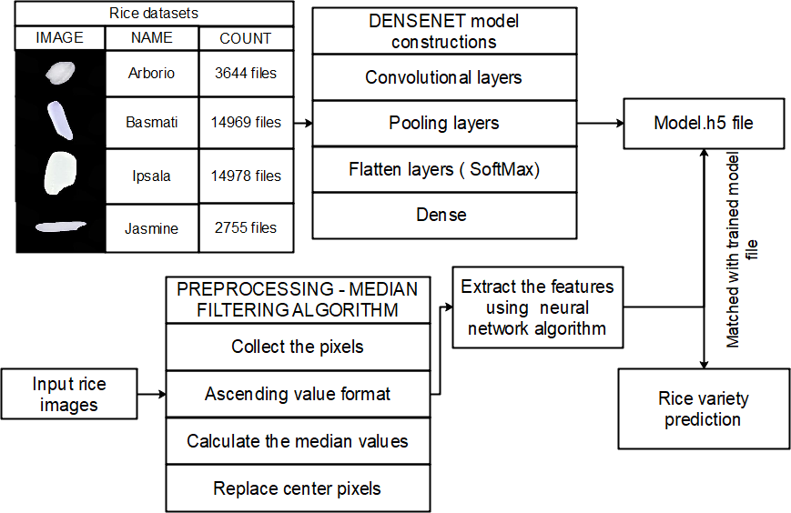
SYSTEM ARCHITECTTURE

Slide 10
BLOCK DIAGRAM

Slide 11
USECASE DIAGRAM

Slide 12
CLASS DIAGRAM

Slide 13
DEPLOYEMENT DIAGRAM

Slide 14
SYSTEM REQUIREMENTS
HARDWARE REQUIREMENTS
Processor : Intel processor 2.6.0 GHZ
RAM : 2 GB
Hard disk : 160 GB
Compact Disk : 650 Mb
Keyboard : Standard keyboard
Monitor : 15 inch color monitor

Slide 15
MODULES IMPLEMENTATIONS
Rice image acquisition.
Build the model.
Input the image.
Classification of rice.

Slide 16
TECHNOLOGY USED
HARDWARE REQUIREMENTS
Processor : Intel processor 2.6.0 GHZ
RAM : 2 GB
Hard disk : 160 GB
Compact Disk : 650 Mb
Keyboard : Standard keyboard
Monitor : 15 inch color monitor

Slide 17
SOFTWARE REQUIREMENTS
Server Side : Python 3.7.4(64-bit) or (32-bit)
Client Side : HTML, CSS, Bootstrap
IDE : Flask 1.1.1
Libraries : Tensorflow, Keras

Slide 18
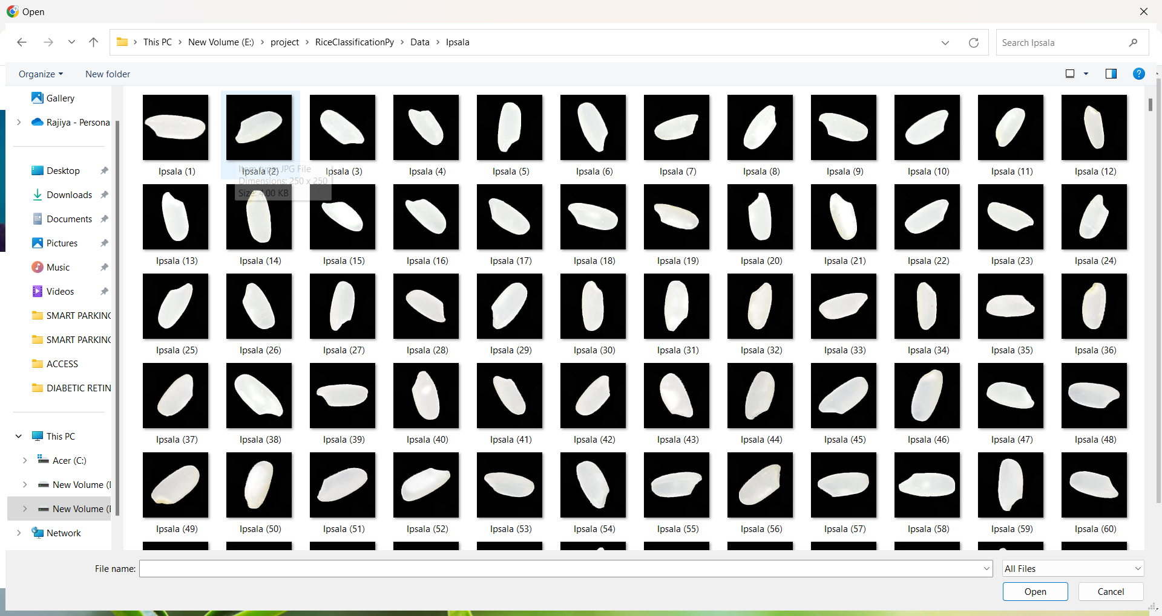
INPUT DATASET

Slide 19
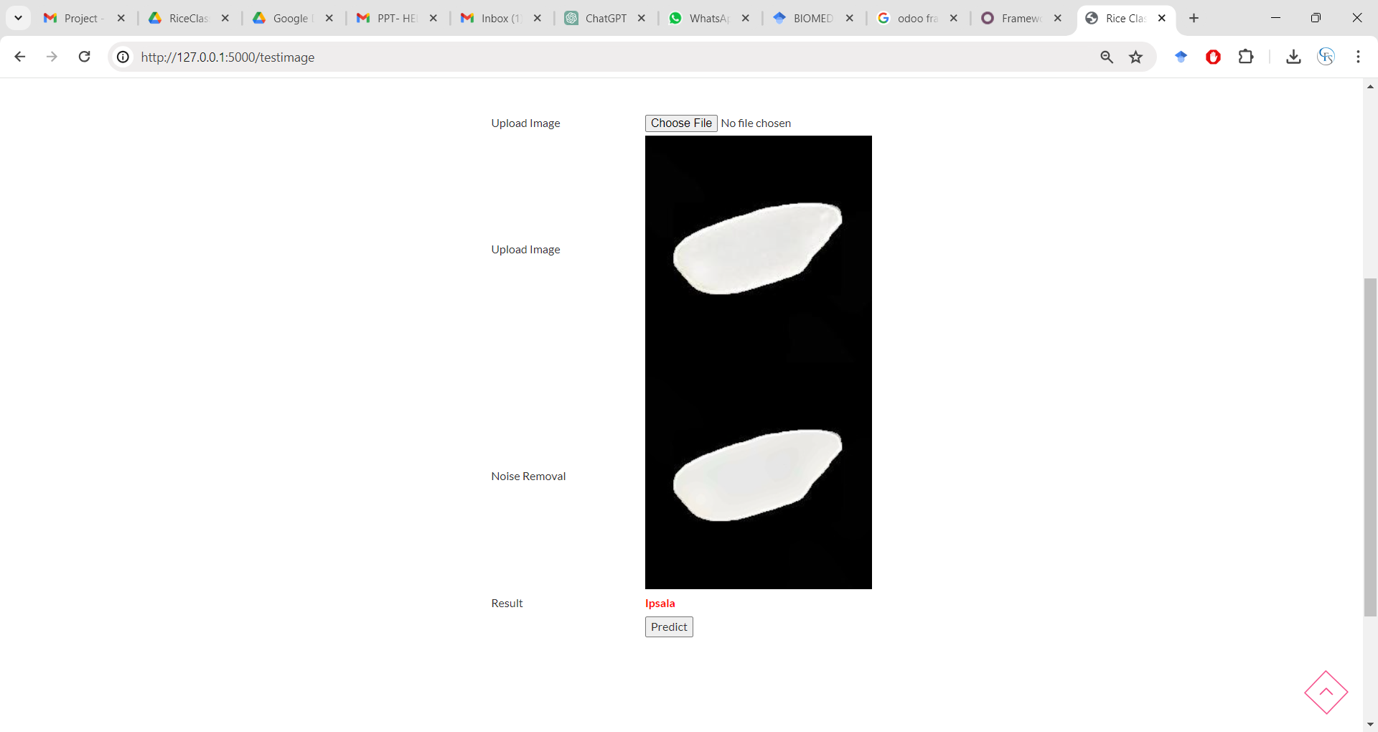
OUTPUT

Slide 20
REFERENCES
1. Tran-Thi-Kim, Nga, et al. "Enhancing the Classification Accuracy of Rice Varieties by Using Convolutional Neural Networks." International Journal of Electrical and Electronic Engineering & Telecommunications 12.2 (2023): 150-160.
2. Rathnayake, Namal, et al. "Age classification of rice seeds in japan using gradient-boosting and anfis algorithms." Sensors 23.5 (2023): 2828.
3. Setiawan, Aji, Kusworo Adi, and Catur Edi Widodo. "Rice Foreign Object Classification Based on Integrated Color and Textural Feature Using Machine Learning." Mathematical Modelling of Engineering Problems 10.2 (2023).
4.Cui, Jiapeng, and Feng Tan. "Rice plaque detection and identification based on an improved convolutional neural network." Agriculture 13.1 (2023): 170.
5. Aggarwal, Meenakshi, et al. "Lightweight federated learning for rice leaf disease classification using non independent and identically distributed images." Sustainability 15.16 (2023): 12149.

Slide 21
THANK YOU

